Slide 1

SafeGuardian: A Web-Based Emergency SOS and Email Notification System
SOA Project Review-4
Saturday, October 30th, 2026
 | Under the Guidance of Dr. Srikanth Cherukuvada Assistant Professor, Department of Computer Science and Engineering, KLH CSE Bowrampet Campus
Team Members B Akhil Varma - 2420030141 K. Vamsidhar - 2420030341 K.V.S. Jaswanth - 2420030467

Slide 2
Outline of Research Work
Focus
Introduction
Literature Survey
Challenges
Research Objectives
Conclusion & Future Work
References
Publications Details

Slide 3
Problem Statement
Women’s safety remains a major concern in today’s world, particularly during situations involving harassment, stalking, unsafe surroundings, or emergencies. Existing safety applications mainly depend on manual SOS activation, basic location sharing, and predefined emergency contacts, which may not be sufficient when a user is unable to interact with the phone or when the surrounding risk needs to be assessed. There is a need for an intelligent safety platform that can combine rapid SOS activation, real-time location monitoring, AI-based threat detection, risk assessment, and coordinated emergency response to provide faster and more context-aware assistance.

Slide 4
Objectives
To make this application:
1. Enable quick SOS activation through a simple, user-friendly interface with a three-second press-and-hold mechanism and browser-based location sharing.
2. Provide reliable emergency notifications by recording SOS incidents, managing registered emergency contacts, and generating email alerts containing available location information.
3. Support coordinated emergency response through a service-oriented application design that integrates frontend, backend, database, and asynchronous notification services to process alerts and track incident status.

Slide 5
Literature Survey
Authors | Title of the Paper | Methodology | Inferences | Limitation/Future work
Harikiran et al. (2016) | Smart Security Solution for Women Based on Internet of Things (IoT) | IoT-based safety device, automatic sensing, communication with nearby people/police | Demonstrates how IoT can support automatic emergency detection and rapid assistance. | Primarily focuses on IoT/device-based safety rather than AI-driven contextual decision-making and coordinated software agents.
Eisenhut et al. (2020) | Mobile Applications Addressing Violence Against Women: A Systematic Review | Systematic review of 327 relevant applications; 171 included and categorized into emergency, avoidance, education, reporting/evidence, and support | Found that 46.78% of reviewed apps primarily provided emergency functions, showing that current solutions are heavily oriented toward one-time emergency response. | Highlights the need for further research into prevention, safety, efficacy, sustainability, and data security.
Akram et al. (2020) | Design of a Smart Safety Device for Women using IoT | IoT safety device with fingerprint verification, automatic alerting, location support, messaging and mobile application | Demonstrates integration of IoT sensing, automatic alerts, location information and communication for women's safety. | Hardware-oriented approach; does not provide a unified agentic AI architecture for threat assessment and intelligent response.
Doria et al. (2021) | Women’s Experiences of Safety Apps for Sexualized Violence: A Narrative Scoping Review | Systematic search and review of studies concerning women's experiences with safety applications | Identified important themes including security, accessibility and knowledge, showing that usability and user experience are important alongside technical features. | Further research is required to address identified gaps and improve the effectiveness and usability of safety applications.
Naaz et al. (2026) | Comprehensive Review on Women Safety Technologies: Indian Perspective | Structured review of women's safety technologies including mobile applications, GPS, IoT, wearables, surveillance and ML | Identifies existing technologies and emphasizes the importance of contextual relevance, accessibility, affordability and improved integration. | Identifies gaps in comprehensive evaluation, Indian-context research, awareness and real-world adoption.

Slide 6
Research Gap Identification
Existing women-safety solutions provide useful capabilities such as SOS alerts, GPS tracking, IoT-based sensing, and emergency communication. However, many applications focus on individual safety features rather than integrating emergency incident management and notification processing into a coordinated workflow.
Most existing applications rely on manual emergency activation and predefined alert mechanisms. There is scope to improve the coordination between user authentication, emergency contact management, location sharing, incident tracking, and notification delivery.
Therefore, the identified project gap addressed by SafeGuardian is the need for a unified web-based platform that integrates these functions through a Service-Oriented Architecture (SOA)-based design, enabling coordinated emergency alert processing and asynchronous email notifications.

Slide 7
Innovation, Creativity, and Novelty
SafeGuardian proposes an integrated emergency safety platform that combines SOS activation, location sharing, emergency contact management, and asynchronous notification processing through a service-oriented design.
Key Innovative Aspects
1. Quick Emergency Activation : Enables users to activate SOS through a simple interface using a three-second press-and-hold mechanism.
2. Location-Based Emergency Alerts : Uses the browser Geolocation API to obtain available location information and include it in emergency notifications.
3. SOA-Based Service Integration : Integrates independent application functions such as authentication, SOS management, location handling, incident management, and notification processing.
4. Asynchronous Notification Processing : Uses a separate Node.js notification worker to process pending email alerts without making email delivery part of the immediate SOS request.
5. Emergency Incident Tracking : Maintains incident records, tracks active and resolved incidents, and provides password-protected incident resolution and SOS history.

Slide 8
Feasibility and Project Plan
Technical Feasibility
Web-Based Architecture: HTML, CSS, JavaScript, Node.js and Express support the development of the application.
SOA-Based Integration: Independent application components communicate through REST APIs for authentication, SOS management, incident handling and notifications.
Database and Notification Support: PostgreSQL stores application data, while Nodemailer, SMTP and a separate Node.js worker support asynchronous email notification processing.
Operational Feasibility
Simple SOS Activation: Users can activate emergency alerts through a three-second press-and-hold button.
Location Sharing: Browser Geolocation API obtains available user location information for emergency alerts.
Emergency Notifications: The system sends email alerts to registered emergency contacts.
Incident Management: Users can track SOS history and resolve active incidents after password verification.

Slide 9
Feasibility and Project Plan
1. Requirements & Research
Weeks 1–2
Problem analysis, requirements and literature survey
2. Architecture & Design
Weeks 2–3
SOA, database and API design.
3. Core Development
Weeks 3–5
Authentication, SOS and location services.
4. AI & Intelligent Response
Weeks 5–7
Email alerts and notification worker.
5. SOA Integration & UI
Weeks 7–10
Frontend, backend and database integration.
6. Testing & Deployment
Weeks 10–12
Testing, debugging, and final demonstration
Time Feasibility

Slide 10
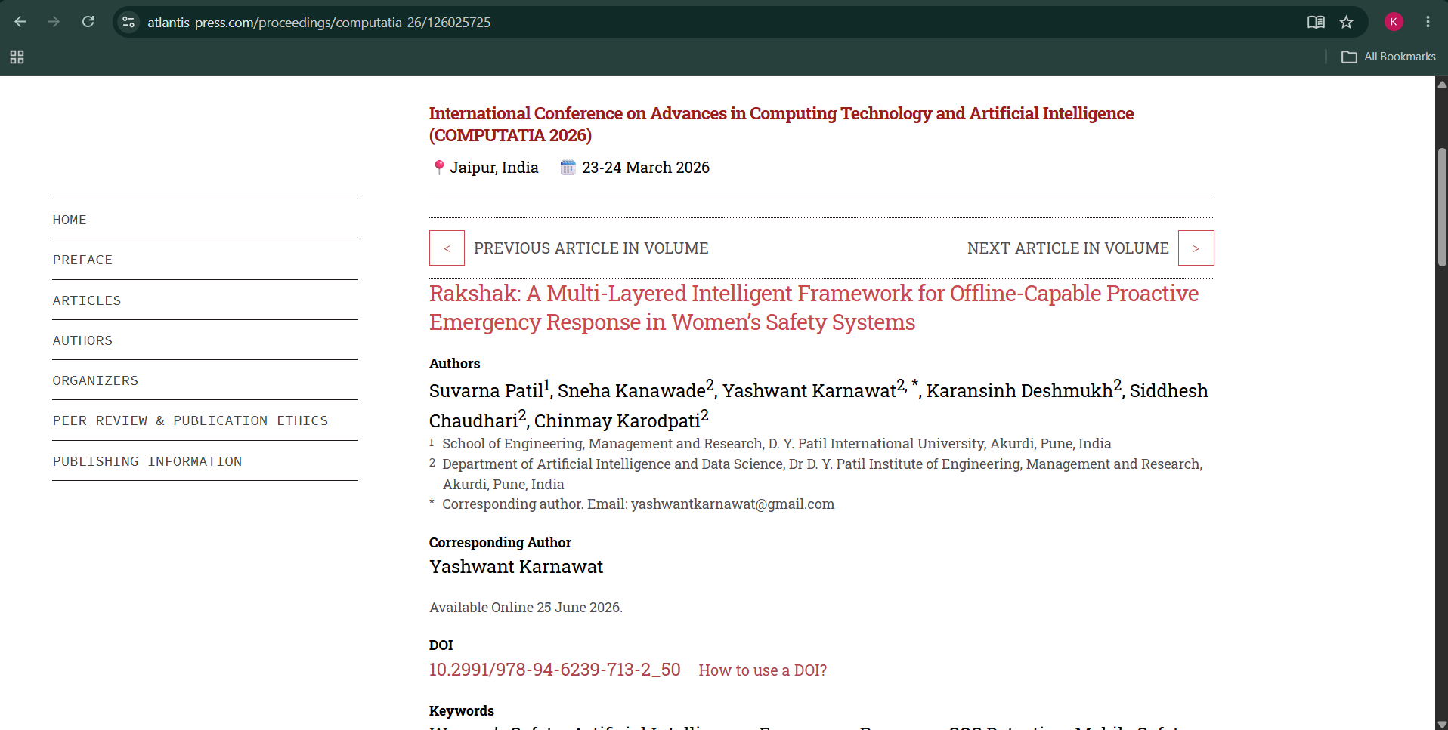
Base Paper

Slide 11
Base Paper Methodology - Rakshak
Danger Situation
Trigger Detection
Danger Detection
SOS
Location
Alert
Contacts
Rakshak uses different ways to detect an emergency, such as voice, eye-blink and tap inputs. When a danger is detected, the system activates SOS, gets the user's location and sends an alert to registered emergency contacts. It also supports emergency communication when internet connectivity is limited.

Slide 12
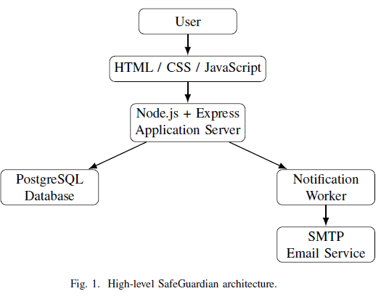
Project Design

Slide 13
Methodology Adopted from Rakshak
Studied the emergency-detection and response approach presented in Rakshak.
Adopted the core concept of initiating an emergency response when a user faces a critical situation.
Incorporated SOS activation as the primary emergency trigger.
Incorporated location acquisition as part of the emergency event.
Incorporated emergency-contact notification as the response mechanism.
Adapted the concept into a lightweight web-based implementation.
Added authenticated users and user-specific emergency contacts.
Implemented asynchronous notification processing using a dedicated worker.
Implemented email-based emergency alert delivery.
Maintained SOS status and history for tracking the emergency lifecycle.

Slide 14

Results

Slide 15
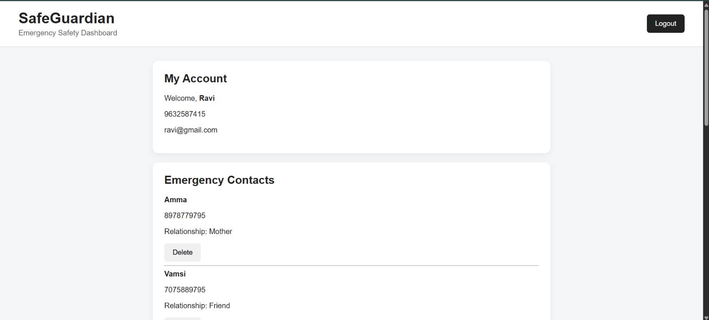
Results

Slide 16
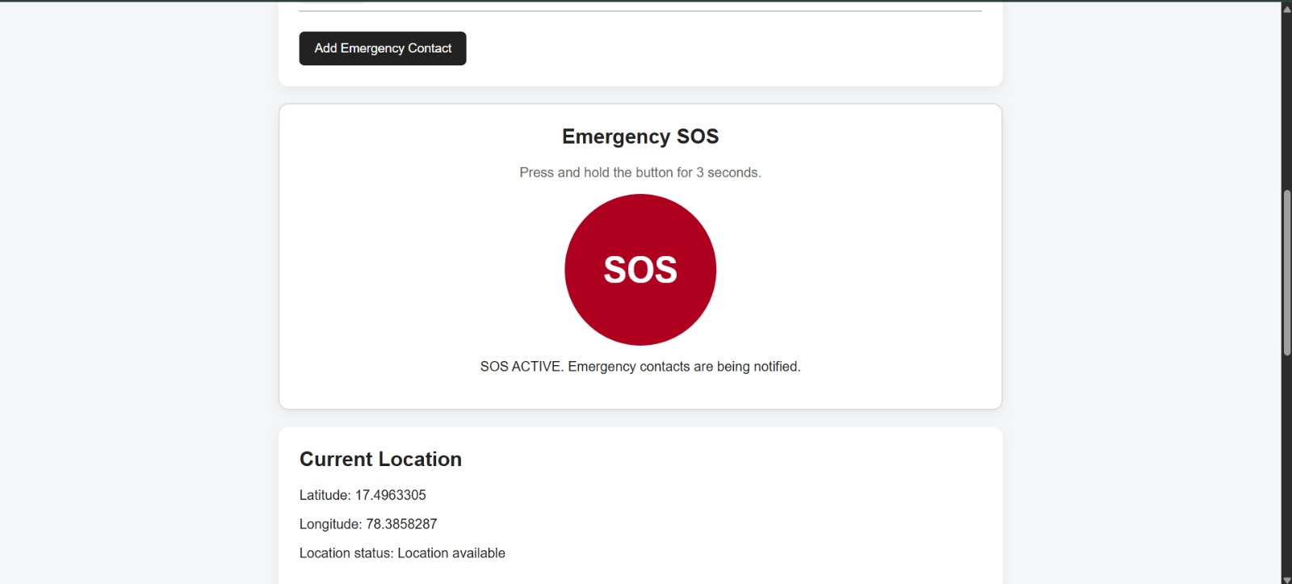
Results

Slide 17
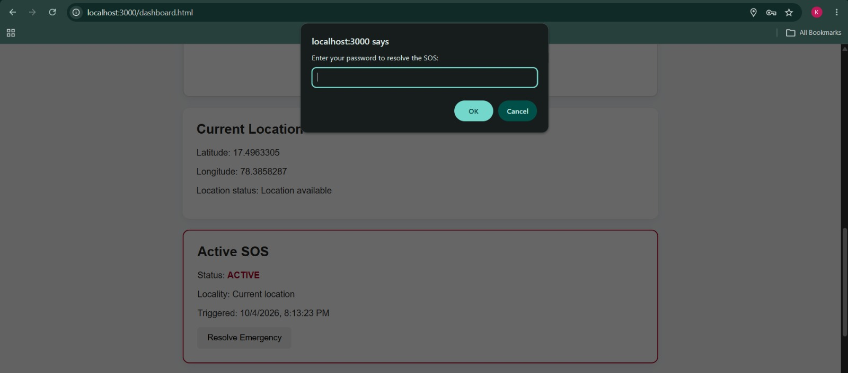
Results

Slide 18
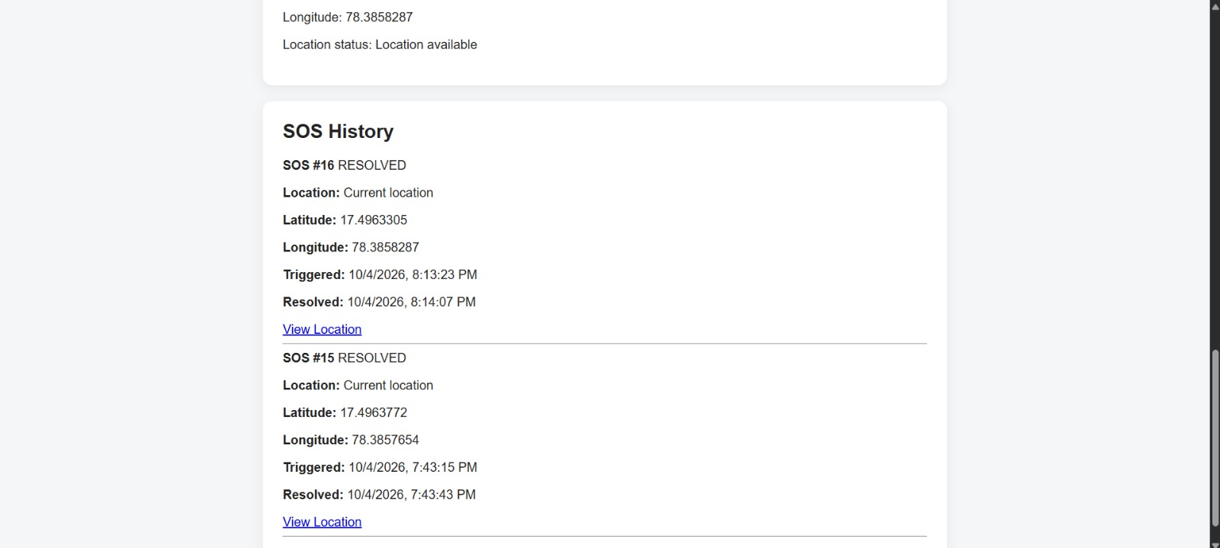
Results

Slide 19
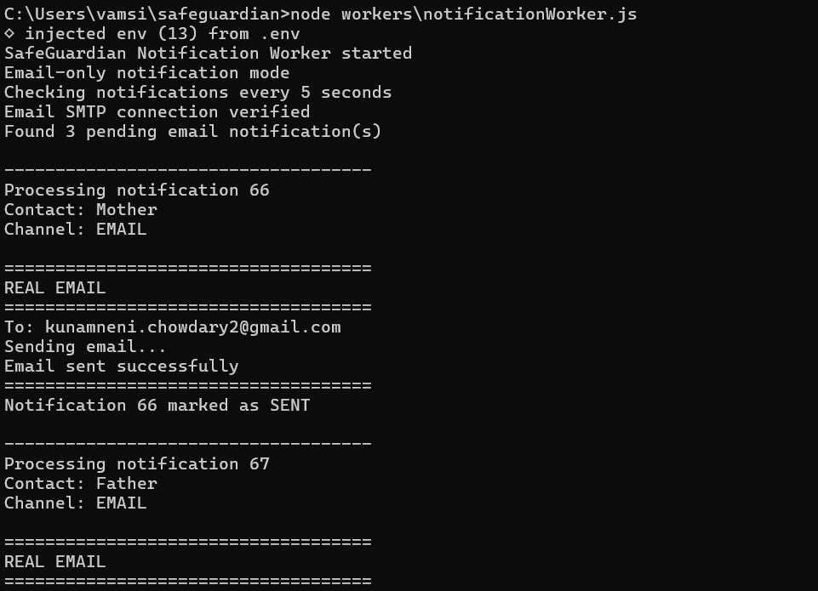
Results

Slide 20
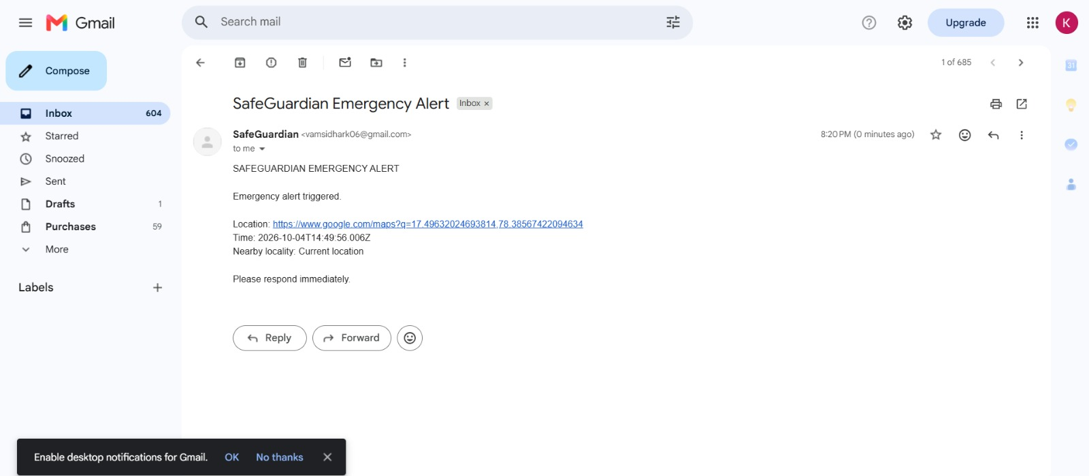
Results

Slide 21
SafeGuardian – Project Evaluation Criteria
1. Accuracy of Results :
Successfully tested SOS activation.
Verified location sharing and email alerts.
Tested incident resolution and SOS history.
Core workflow functions as expected.
2. Technical Competence :
Developed using HTML, CSS, JavaScript and Node.js.
Integrated Express.js with PostgreSQL.
Implemented REST APIs and session authentication.
Used Nodemailer and an asynchronous notification worker.

Slide 22
SafeGuardian – Project Evaluation Criteria
3. Innovative and Sustainable Features :
Three-second press-and-hold SOS activation.
Location-based emergency email alerts.
SOA-based application integration.
Asynchronous notification processing.
Extendable architecture for future AI-based features.
4. Utility to Society :
Supports women during emergency situations.
Helps notify trusted emergency contacts.
Shares available location information.
Maintains emergency incident records.
Provides a simple and accessible web interface.

